Slide 1
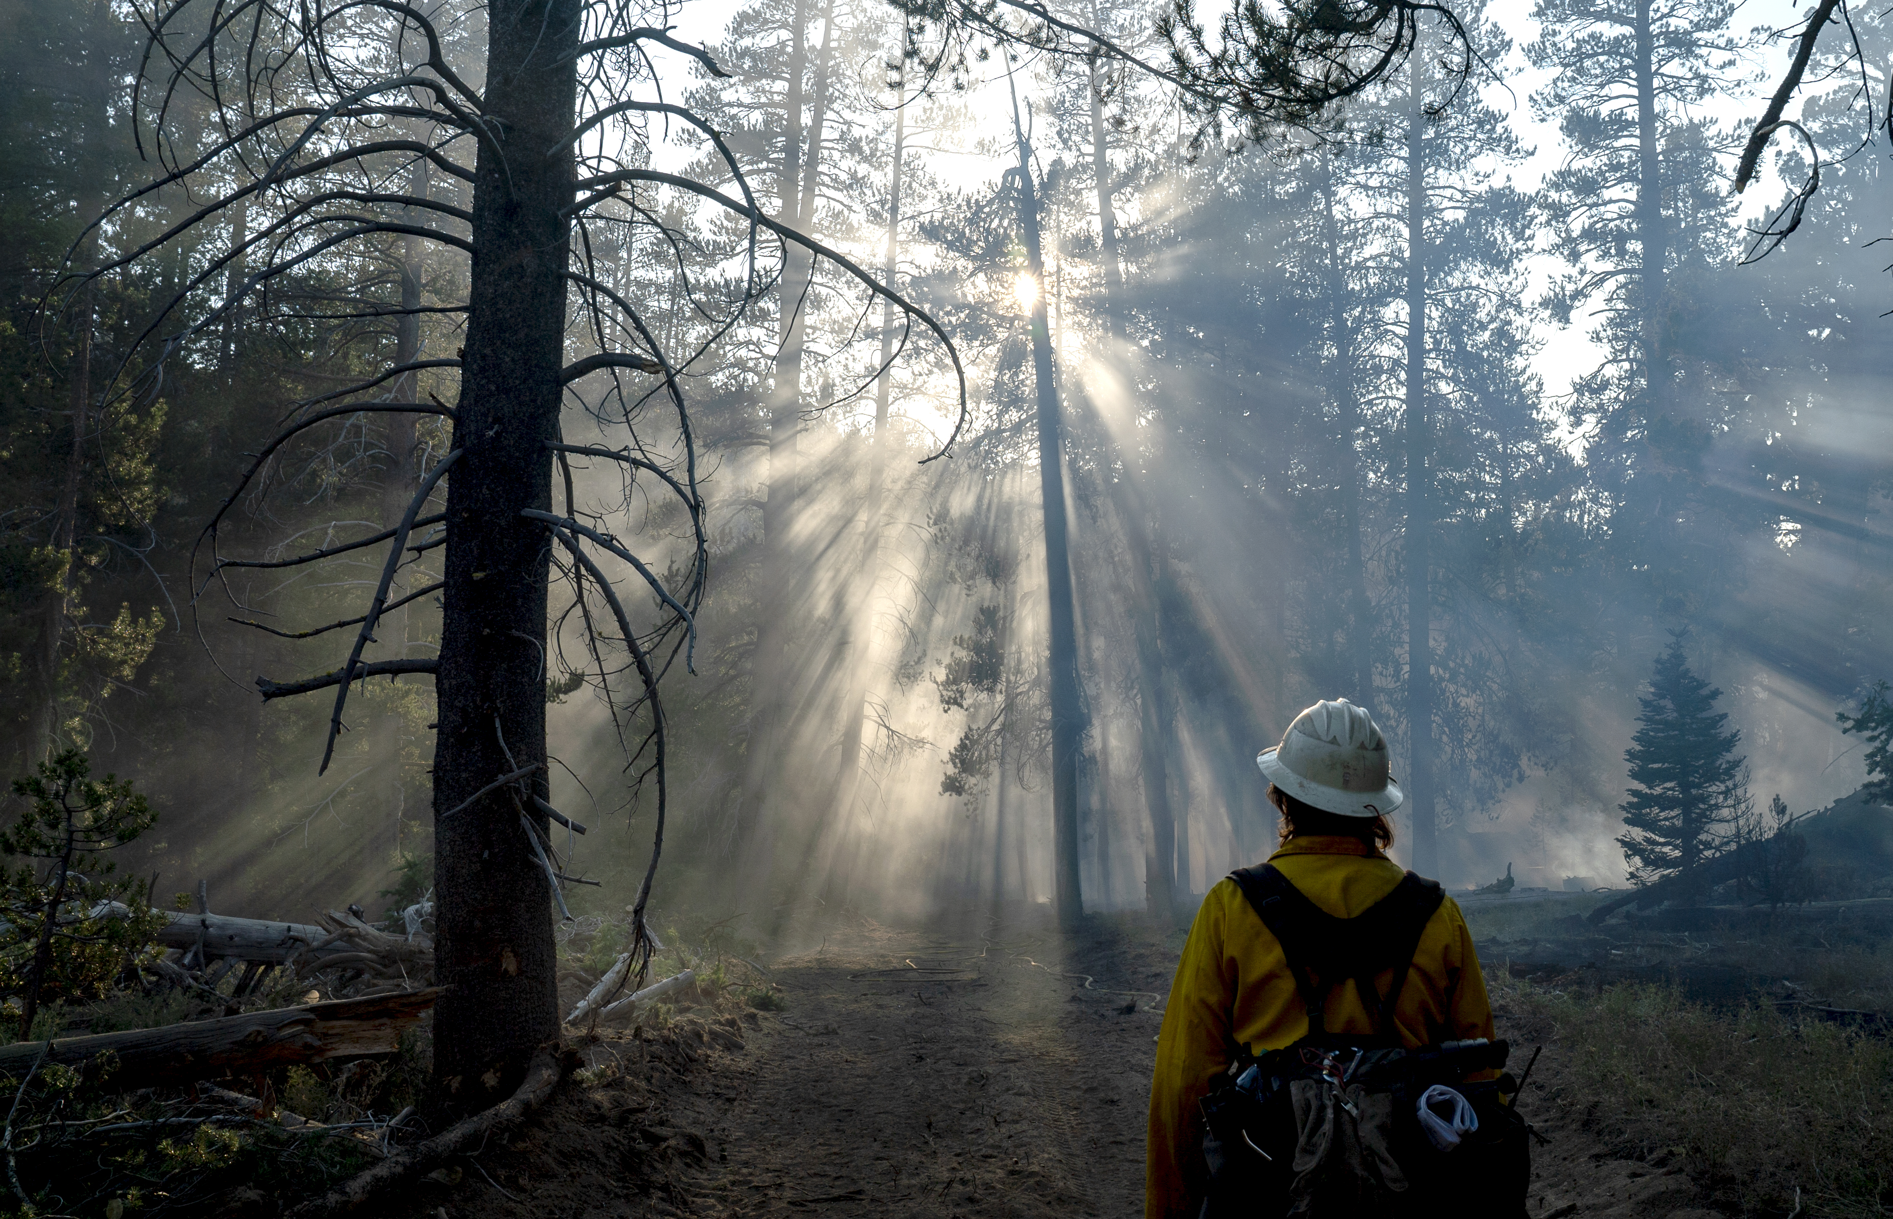

USDA – U.S. FOREST SERVICE
IIPA
VIPR NextGen
Locate Opportunities (Solicitations)

Slide 2
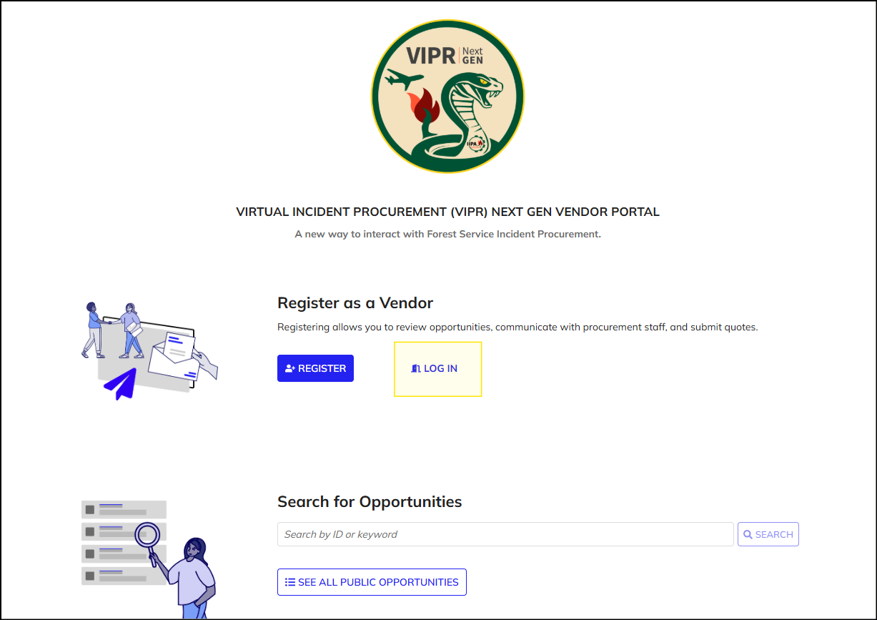
Locate Opportunities (Solicitations)
Log in as a vendor
Navigate to the Vendor Portal. Click the "Log In" button and use your login.gov credentials to log into VIPR Next Gen.
Refer to the "Register and Log in as a Vendor" guide if you need assistance with this step

Slide 3
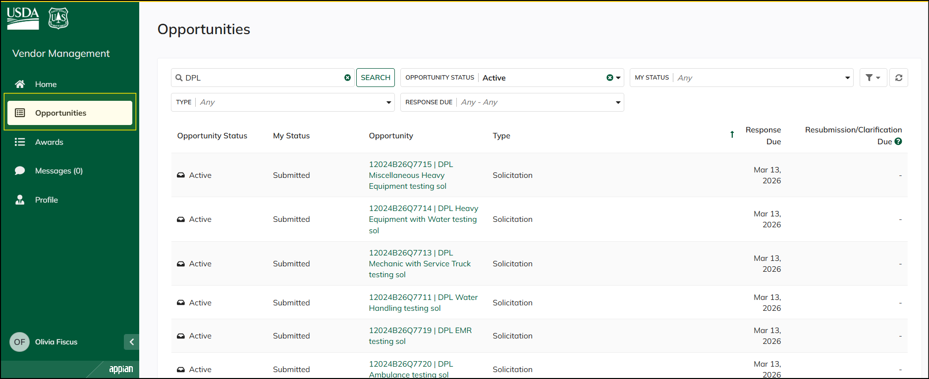
Locate Opportunities (Solicitations)
Locate and Interact with Opportunities
Access the "Opportunities" tab.
Note that Solicitations are referred to as "Opportunities" in the system

Slide 4
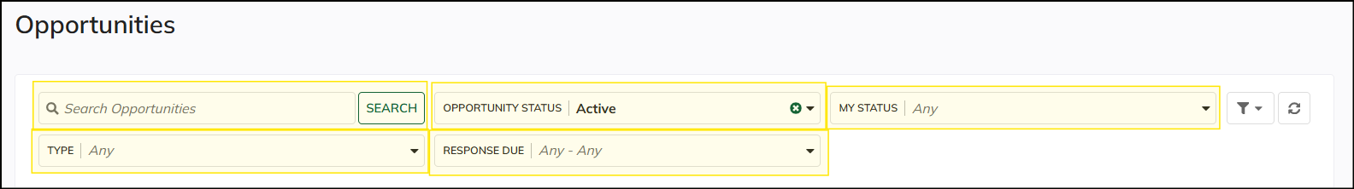
Locate Opportunities (Solicitations)
Locate and Interact with Opportunities
You can search for opportunities using the search bar.
You can filter opportunities by the following:
Opportunity Status
My Status
Type
Response Due

Slide 5
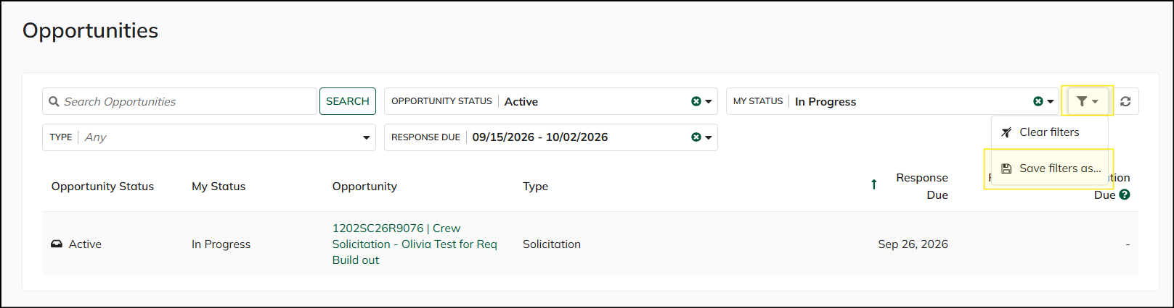
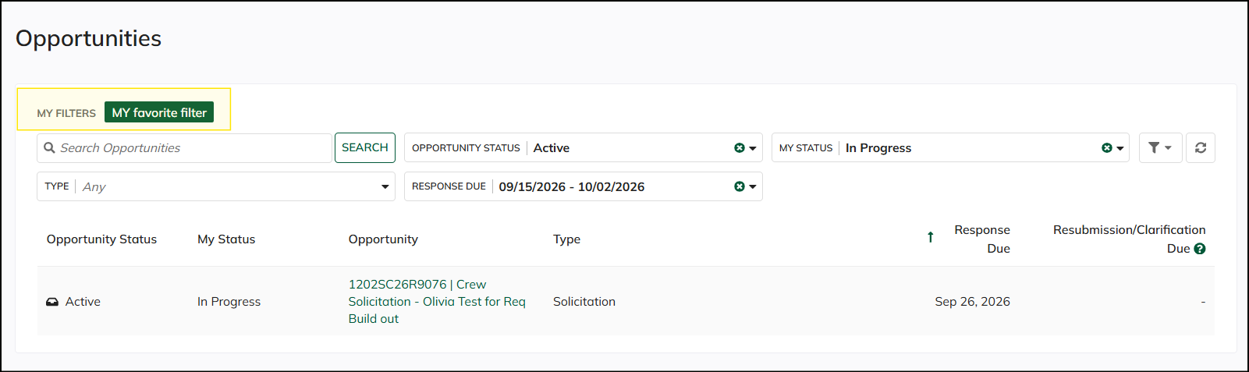
Locate Opportunities (Solicitations)
Locate and Interact with Opportunities
If there is a filter that you use often, you can save the filter using the "Save Filter as" button. Give your saved filter a name when you do this. Once you save it, you can easily toggle it on and off to make locating opportunities easier.

